Slide 1
Change Tapas – Change vs. Transition

Slide 2
Change vs. Transition
Change
Situational or physical
It's an event
External to us
"Happens" to us
Often has a date associated with it
Starts with something ending
Hinges on the new thing
Transition
Psychological
Happens inside of us
Invisible
Takes a LONG time
Starts with having to give things up
Finishes with a beginning
Depends on letting go – the ending you have to make to leave the old situation behind
Change tapas – change vs. transition
Notes:
Change is not the same as transition. Change is situational. Change is an event which happens to us. It starts with something new and often has a date associated with it.
Transition is a gradual psychological process we go through to come to terms with the new situation. It happens inside of us. It is invisible. It starts with having to “end” or “give things up”. It typically takes months or years to fully transition to a change.

Slide 3
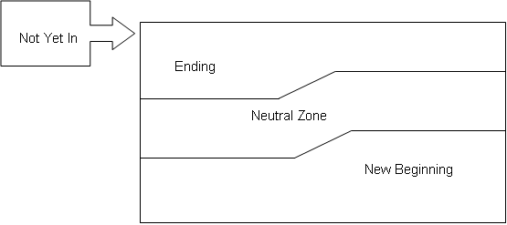
Three Phases of Transition
Change tapas – change vs. transition
Notes:
Ending:
Transition begins with letting go of something. All changes, even those you look forward to, begin with endings and losses. A new job may be a change you are looking forward to. To make that change you may have to let go of your former peer group or perhaps you have to give up the feeling of competence as you learn your new job.
Neutral Zone:
This is the time between the old reality and the new reality. It is a time when the old way is gone and the new doesn’t feel comfortable. It can also be a time of creativity, renewal and development.
New Beginning:
A change can happen on a planned schedule but a new beginning cannot. A new beginning occurs when people are ready to make the emotional commitment to the change. This happens when they have the new understandings, new values and attitudes to support the change.
“Most people do not resist change. What we resist is transition.”
Bridges, William. Managing Transitions: Making the most of change. Don Mills, Addison-Wesley, 1991.

