Slide 1
Change Tapas – Diffusion of Innovation

Slide 2
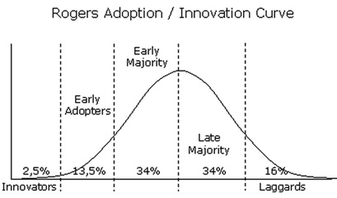
Change tapas – innovation
Notes:
Innovators: Those who take the pain to come out with some innovation
Early Adopters: Those who take the initiative to adopt to the innovation
Early Majority: Those who adopt the change after a varying degree of time that is significantly longer than the innovators or early adopters
Late Majority: Those who adopt the new idea and change only after it has been accepted by the majority
Laggards or Traditionalists: Those who are will only change once it has been accepted by all and becomes the trend or are required to make the change
For further information check out - https://en.wikipedia.org/wiki/Diffusion_of_innovations
See

Slide 3
Videos
Diffusion of Innovation:
Part 1 - The Adoption Curve
Part 2 - The “S” Curve
Dancing Guy Video

