Slide 1
Change Tapas – Ladder of Inference

Slide 2
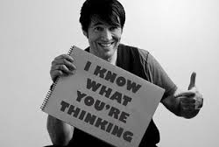
Jumping to Conclusions
What is jumping to conclusion?
Why can this happen more during times of change?
Why is jumping to conclusions a problem?
Change Tapas – Ladder of Inference
Notes:
If you jump to conclusions, you decide something is true, or make a judgment about something, before having enough information to be sure you're right.
This is explained through the ladder of inference…

Slide 3
Change Tapas – Ladder of Inference

Slide 4
Ladder of Inference - Videos
https://www.youtube.com/watch?v=KJLqOclPqis
https://www.youtube.com/watch?v=K9nFhs5W8o8
https://www.youtube.com/watch?v=RwiELtWVyVc
https://www.youtube.com/watch?v=7N8-4FgWWSw
Change Tapas – Ladder of Inference
Notes:
Choose the one(s) are right for you and your group.

Slide 5
How to Avoid
Pay attention and move down the ladder.
Question your assumptions and conclusions.
Ask yourself:
What data and beliefs did you filter into your observations and why?
Are your assumptions valid and supported by facts?
Be mindful of your ladder and help others to see theirs.
Change Tapas – Ladder of Inference

