Slide 1
Change Tapas – Marathon Effect

Slide 2
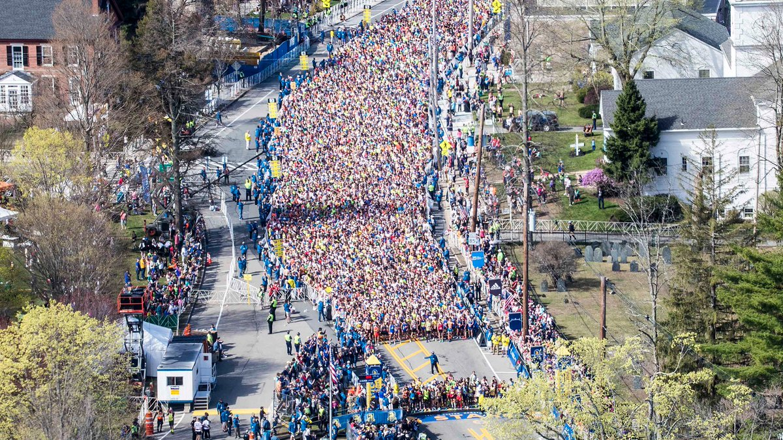
Notes:
This is a picture of the start line of the Boston Marathon. There are a total of about 30,000 runners. Those with the fastest qualifying times start at the beginning of the pack. They leave in waves with the first group starting at 8:40am and the last wave starting at 11:15am
How do you think change is like a marathon?
Everyone starts at a different time – some people may finish before others have even past the starting line (e.g., begun to hear about the change, understand the change, or action the change). Leaders of change may have evolved their thinking or expectations because they have been working on the change for a longer time forgetting that others have not yet started.
You may also hear about others experience of the change – those who are farther ahead or behind you.

